Slide 1
ML techniques for C(antib) predictions
REVIEWERs:
Saadiallakh “SASHA” Normatov
Vladislav Masliy
Yulia Ashina
Infochemistry scientific center (ISC)
1st year master students
ITMO

Slide 2
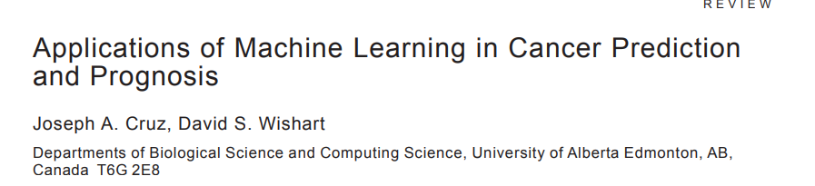
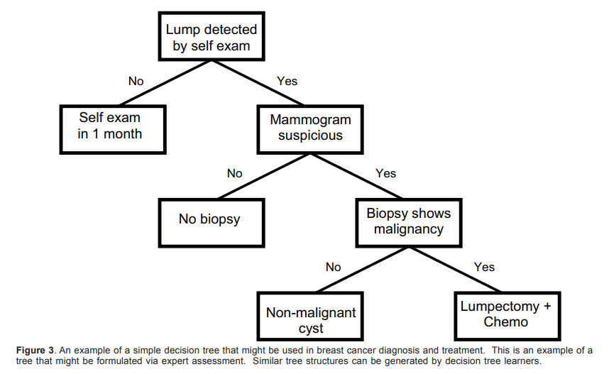
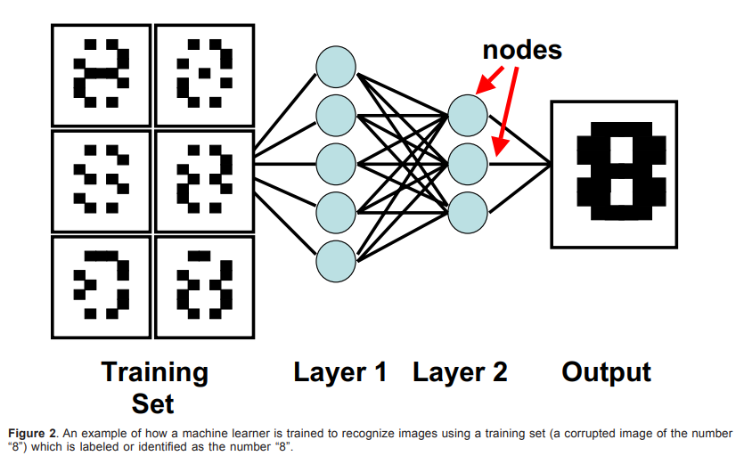
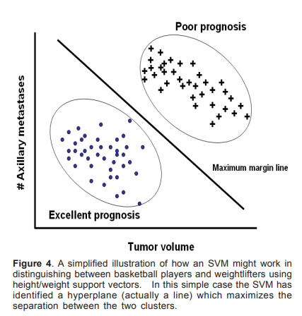
https://journals.sagepub.com/doi/pdf/10.1177/117693510600200030

Slide 3
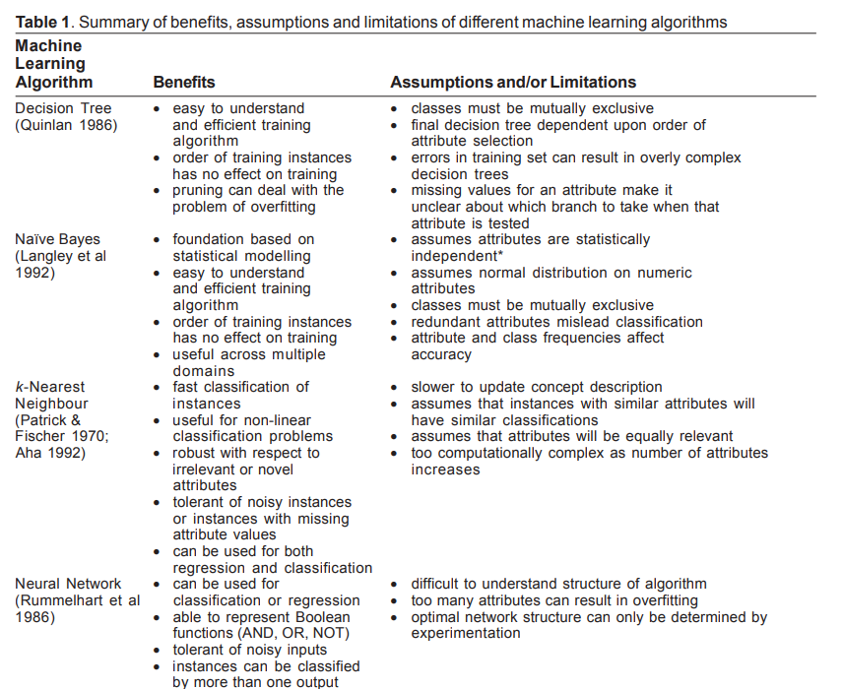
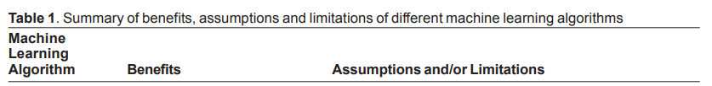
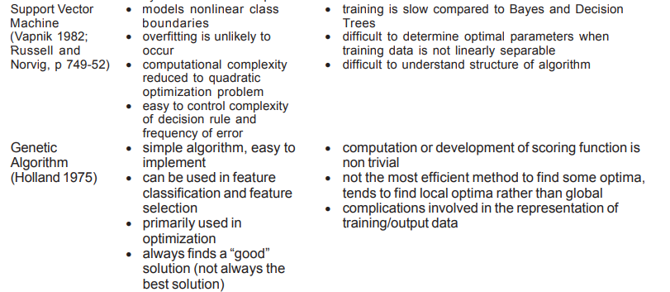

Slide 4
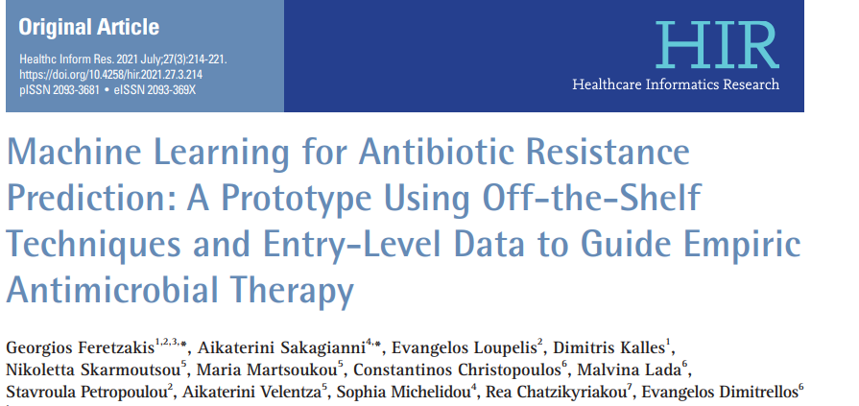
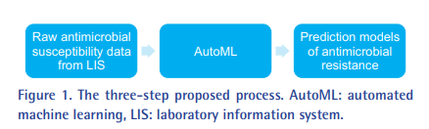
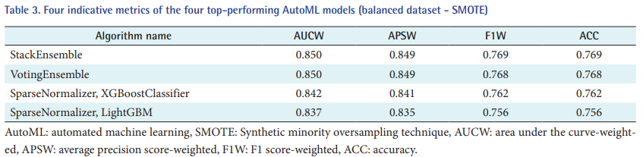
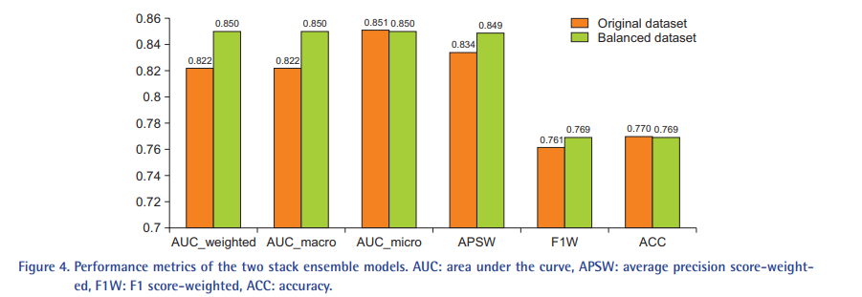
Literature review
DOI:10.4258/hir.2021.27.3.214
This study evaluated the results of applying AutoML of the Microsoft Azure platform to two internal medicine departments’ antimicrobial susceptibility datasets. In this article, we propose the use of AutoML as a decision tool for physicians since it can be more readily applied even by nonexperts (e.g., a data scientist may be needed for a full-blown investigation, but a physician can gain some insight with a relatively smooth learning curve) and, as we showed, the deduced models have good performance

Slide 5

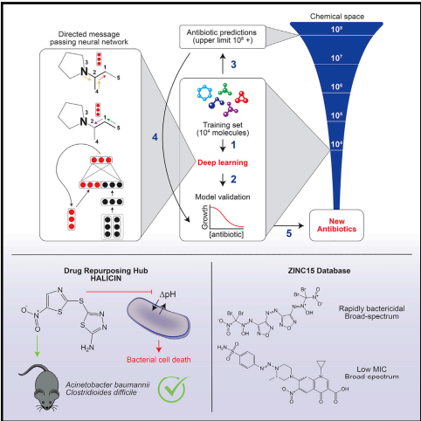
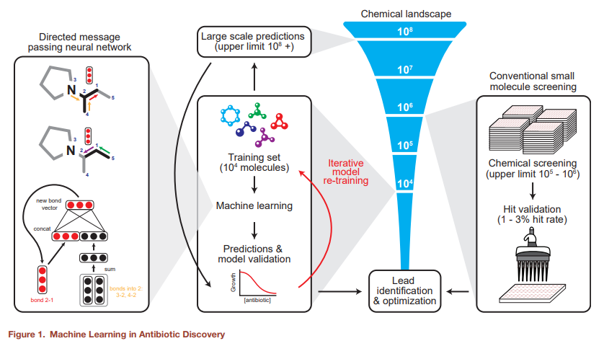
https://www.cell.com/cell/pdf/S0092-8674(20)30102-1.pdf
Due to the rapid emergence of antibiotic-resistant bacteria, there is a growing need to discover new antibiotics. To address this challenge, researchers trained a deep neural network capable of predicting molecules with antibacterial activity. Here there are performed predictions on multiple chemical libraries and discovered a molecule from the Drug Repurposing Hub—halicin—that is structurally divergent from conventional antibiotics and displays bactericidal activity against a wide phylogenetic spectrum of pathogens including Mycobacterium tuberculosis and carbapenem-resistant Enterobacteriaceae.

Slide 6
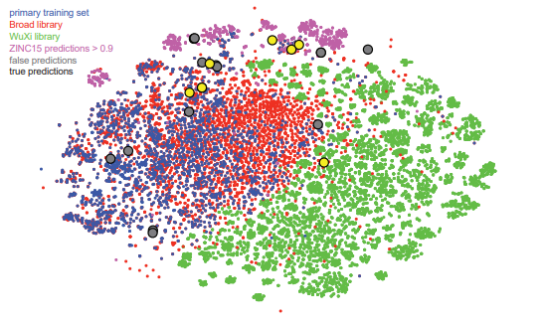
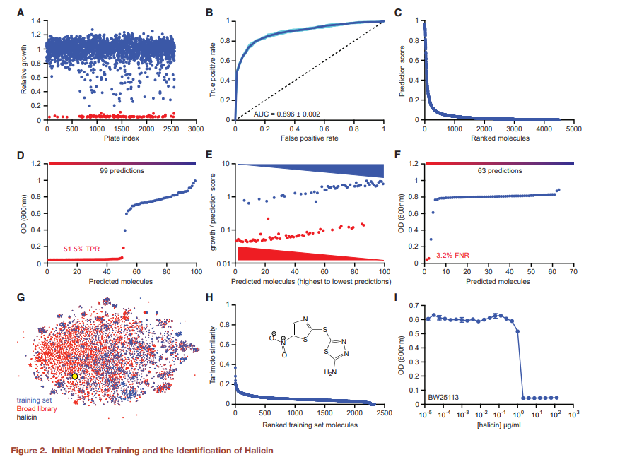
https://www.cell.com/cell/pdf/S0092-8674(20)30102-1.pdf
t-SNE of all molecules from the primary training dataset (blue), the Drug Repurposing Hub (red), the WuXi anti-tuberculosis library (green), the ZINC15 molecules with prediction scores >0.9 (pink), false-positive predictions (gray), and true-positive predictions (yellow). See also Figure S5 and Tables S5, S6, and S7.

Slide 8
RMSE TABLE
Antibiotic | Decision Tree | Random Forest | Gradient Boosting
Tetracycline | 3.9018800819844103e-07 | 3.899370690763058e-07 | 3.891938587830508e-05
Penicillin | 1.1688254335248097e-07 | 1.1683256841467761e-07 | 1.1661113305791518e-07
Streptomycin | 8.087206101875566e-06 | 8.087709188918512e-06 | 8.072899376388788e-06
Cefazoline | 5.075716155234572e-07 | 5.075668051638683e-07 | 2.5761662062913835e-11
Ceftiofur | 4.2920773428820995e-07 | 4.292170580280685e-07 | 4.291931936758586e-07

Slide 9
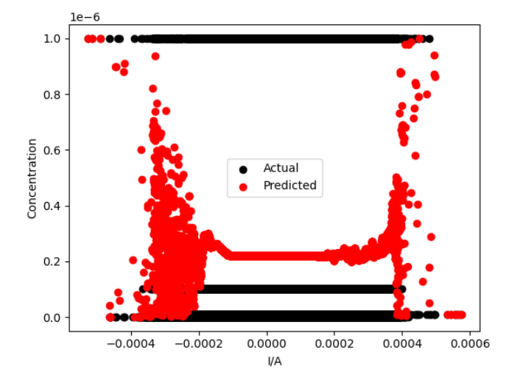
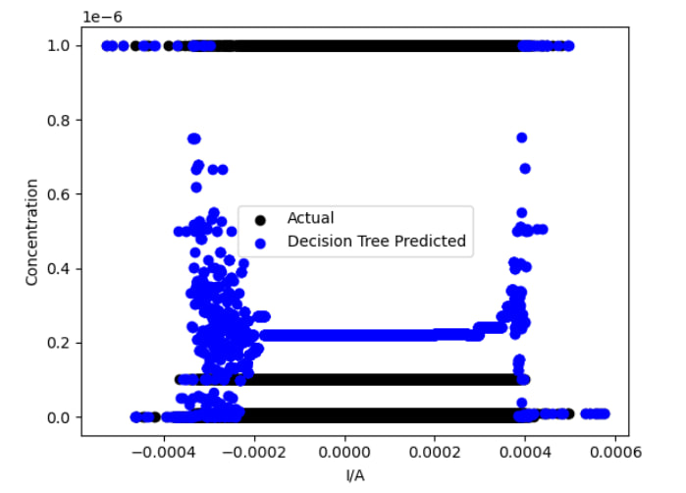
DECISION TREE vs RANDOM FOREST
Tetracycline
Root Mean Squared Error (RMSE): 3.899370690763058e-07
RANDOM FOREST
Root Mean Squared Error (RMSE): 3.9018800819844103e-07
DECISION TREE
ITMO

Slide 10
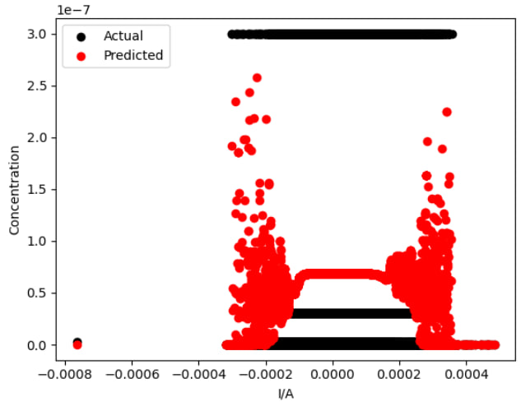
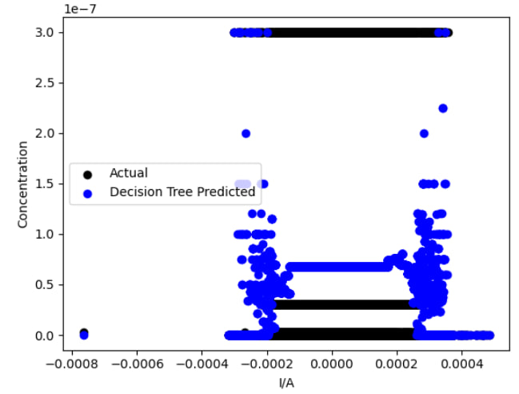
DECISION TREE vs RANDOM FOREST
Penicillin
Root Mean Squared Error (RMSE): 1.1683256841467761e-07
RANDOM FOREST
Root Mean Squared Error (RMSE): 1.1688254335248097e-07
DECISION TREE
ITMO

Slide 11
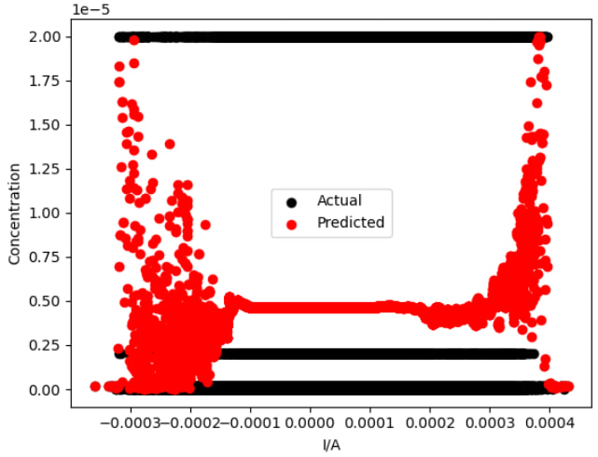
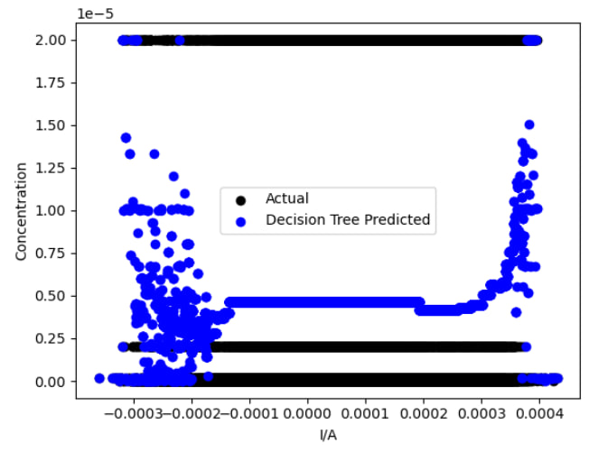
DECISION TREE vs RANDOM FOREST
Streptomycin
Root Mean Squared Error (RMSE): 8.087709188918512e-06
RANDOM FOREST
Root Mean Squared Error (RMSE): 8.087206101875566e-06
DECISION TREE
ITMO

Slide 12
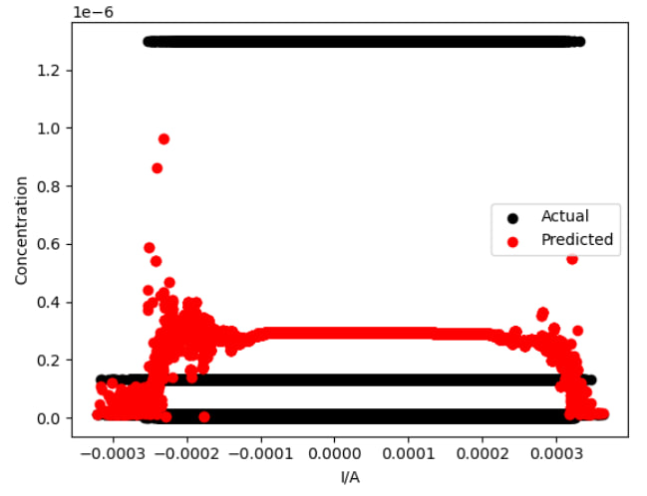
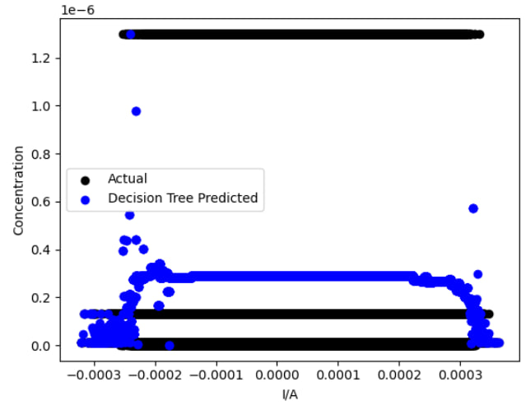
DECISION TREE vs RANDOM FOREST
Cefazoline
Root Mean Squared Error (RMSE): 5.075668051638683e-07
RANDOM FOREST
Root Mean Squared Error (RMSE): 5.075716155234572e-07
DECISION TREE
ITMO

Slide 13
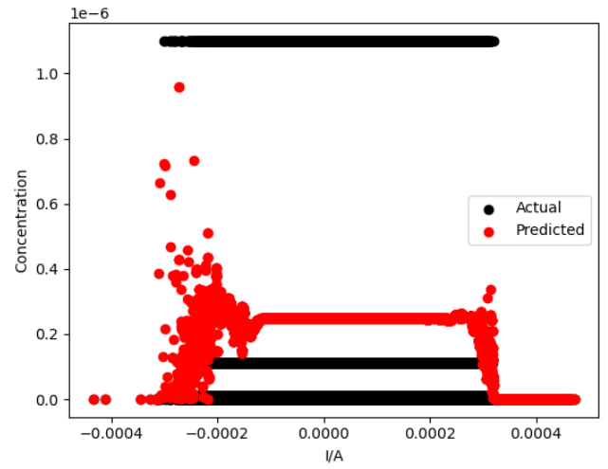
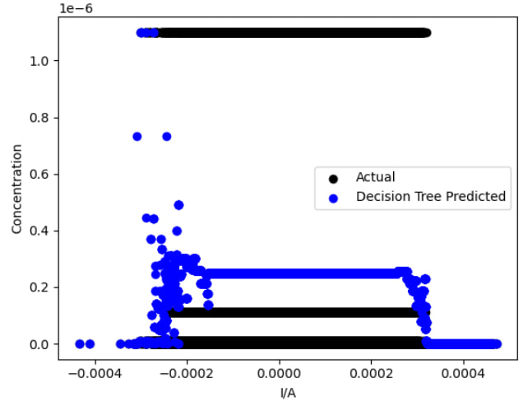
DECISION TREE vs RANDOM FOREST
Ceftiofur
Root Mean Squared Error (RMSE): 4.292170580280685e-07
RANDOM FOREST
Root Mean Squared Error (RMSE): 4.2920773428820995e-07
DECISION TREE
ITMO

Slide 14
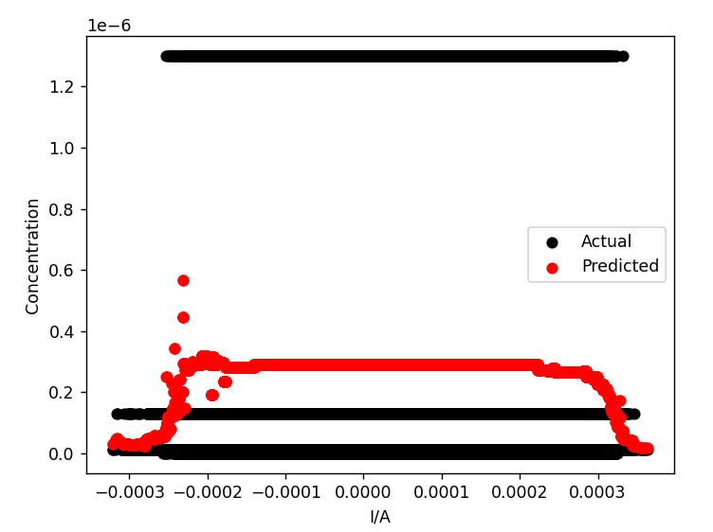
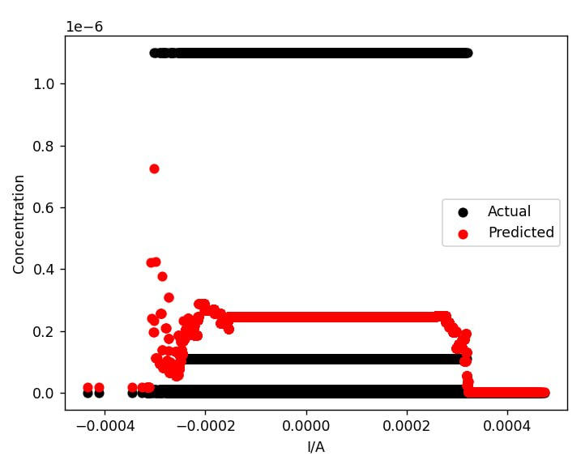
GRADIENT BOOSTING
Root Mean Squared Error (RMSE): 2.5761662062913835e-11
CEFAZOLINE
Root Mean Squared Error (RMSE): 4.291931936758586e-07
CEFTIOFUR
ITMO

Slide 15
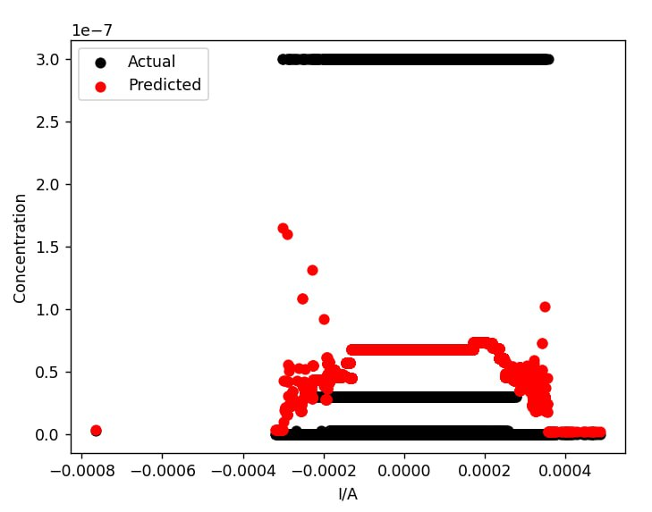
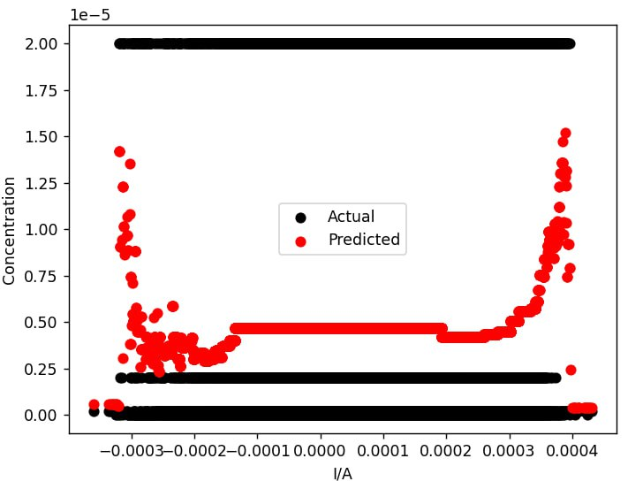
GRADIENT BOOSTING
Root Mean Squared Error (RMSE): 1.1661113305791518e-07
PENICILLINE
Root Mean Squared Error (RMSE): 8.072899376388788e-06
STREPTOMYCIN
ITMO

Slide 16
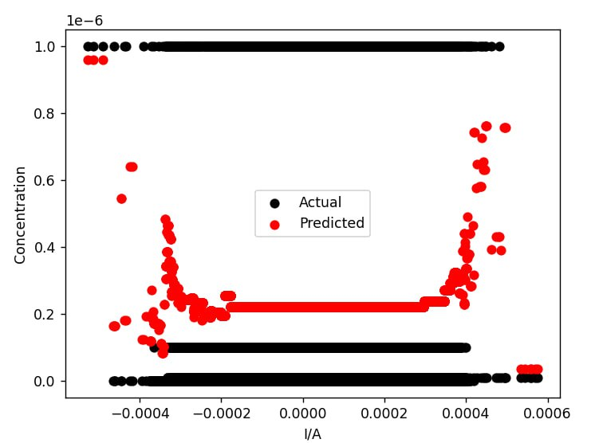
GRADIENT BOOSTING
Root Mean Squared Error (RMSE): 3.891938587830508e-05
TETRACYCLINE
ITMO

Slide 17
Data structure (classification)
Response (1 row – 1 voltammogramm)
Classifiers
Tetracycline data ( 225 x 1040)
1
2
3
Ceftiofur data (450 x 1040)
Cefazoline data (450 x 1040)

Slide 18
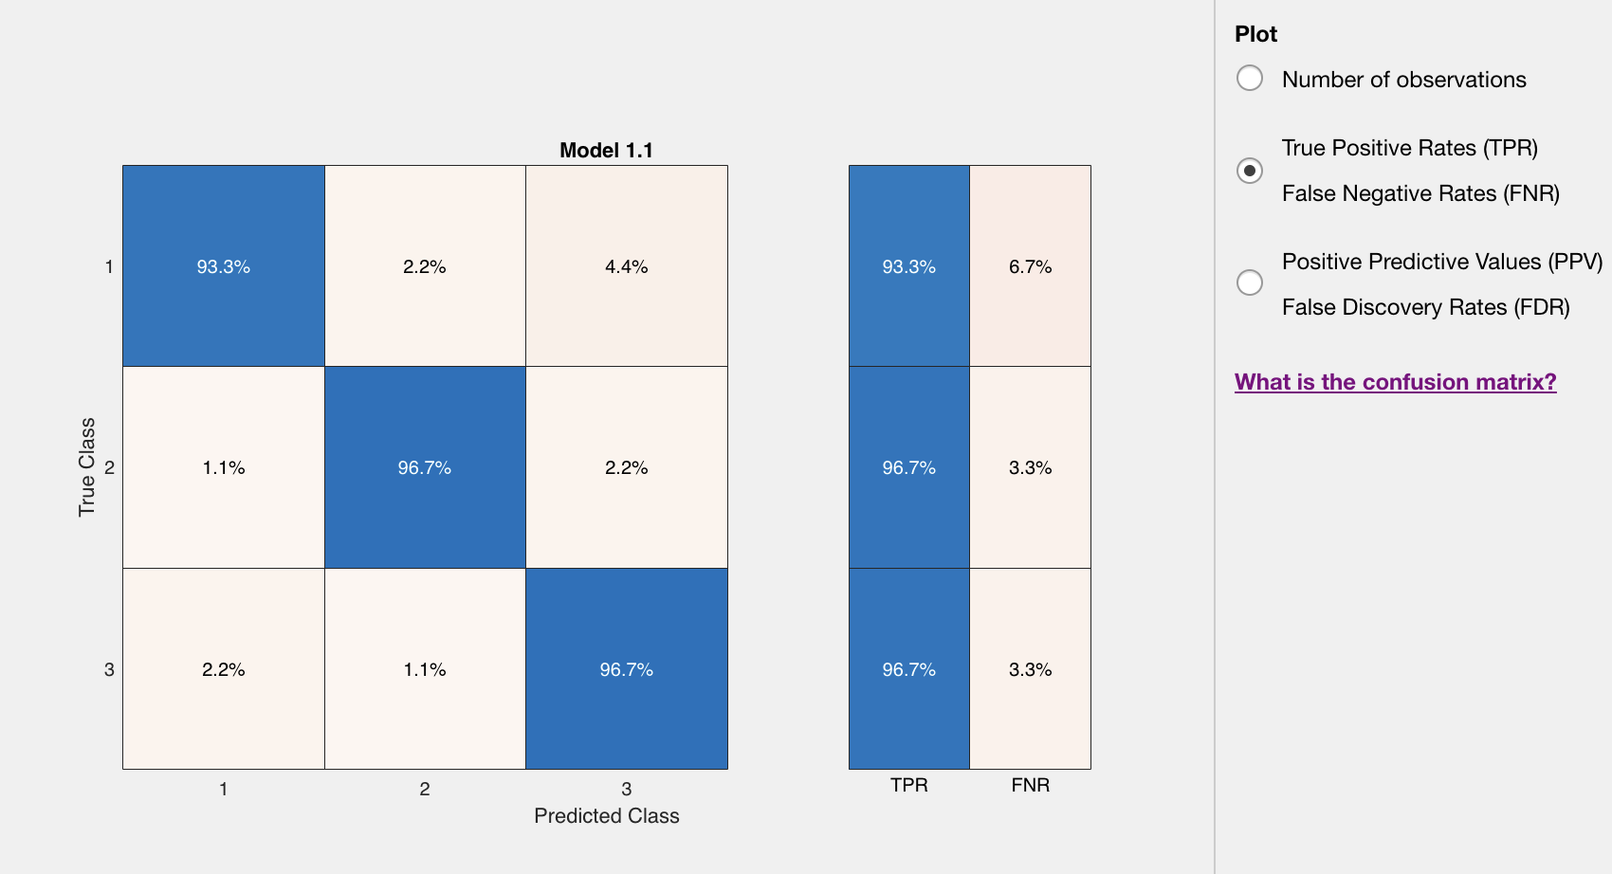
Decision tree
The true positive rate (TPR) represents the proportion of actual positive cases that were correctly identified or classified as positive by the model.

Slide 19
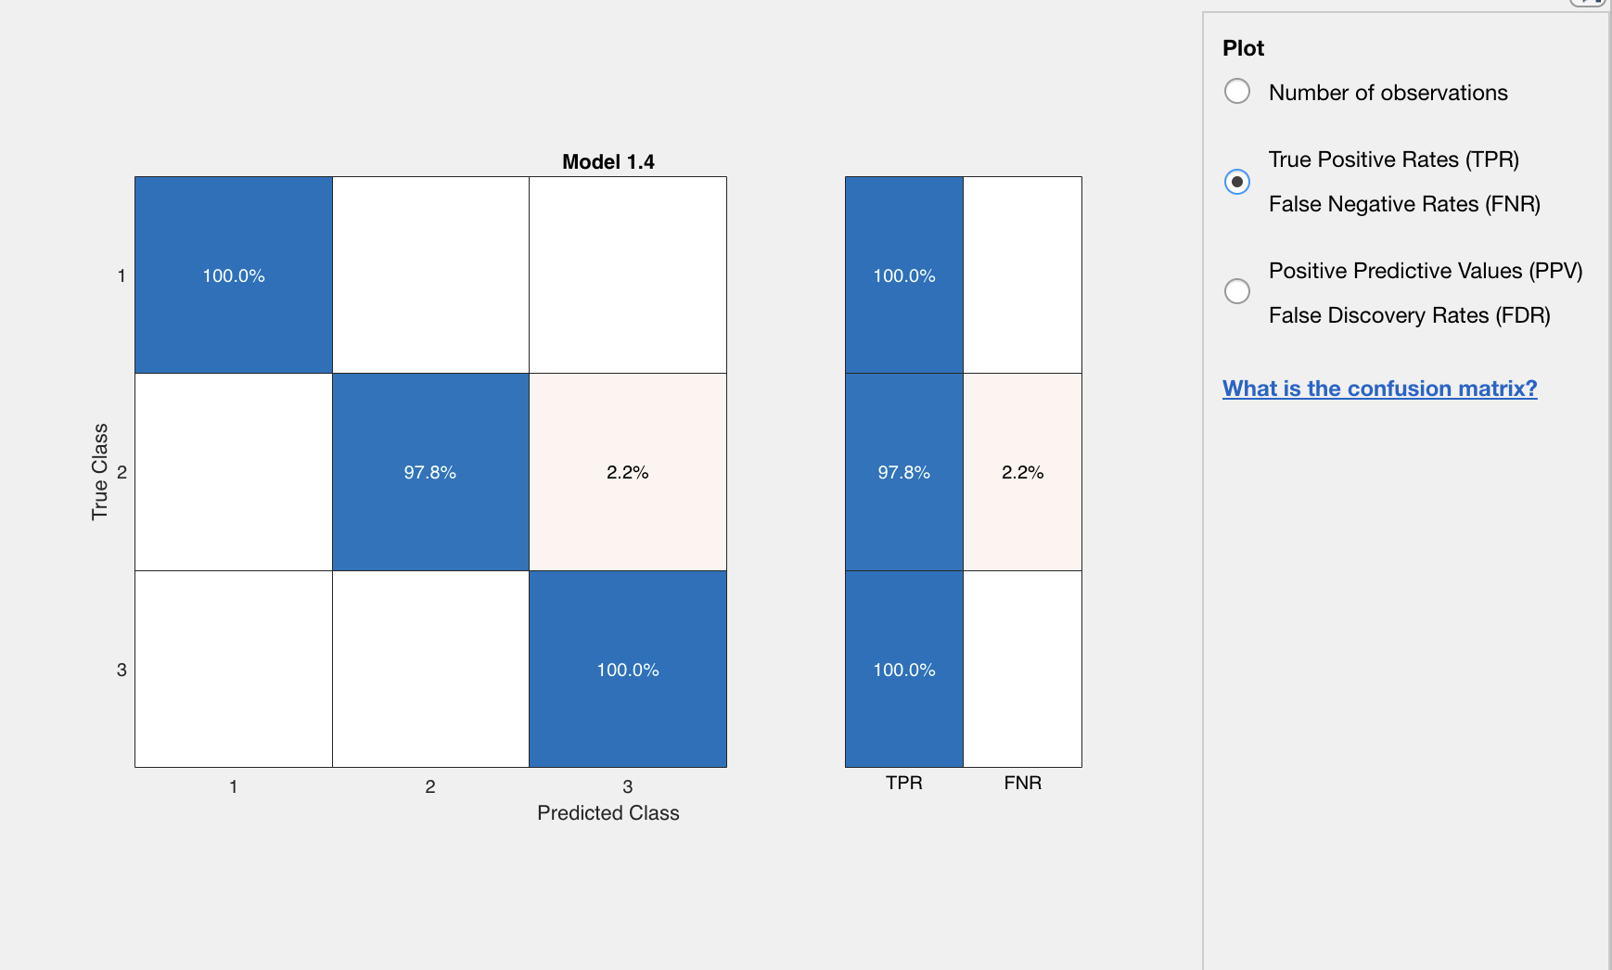
KNN
1 – tetracycline 2 – ceftiofur
3 – cefazoline

Slide 20
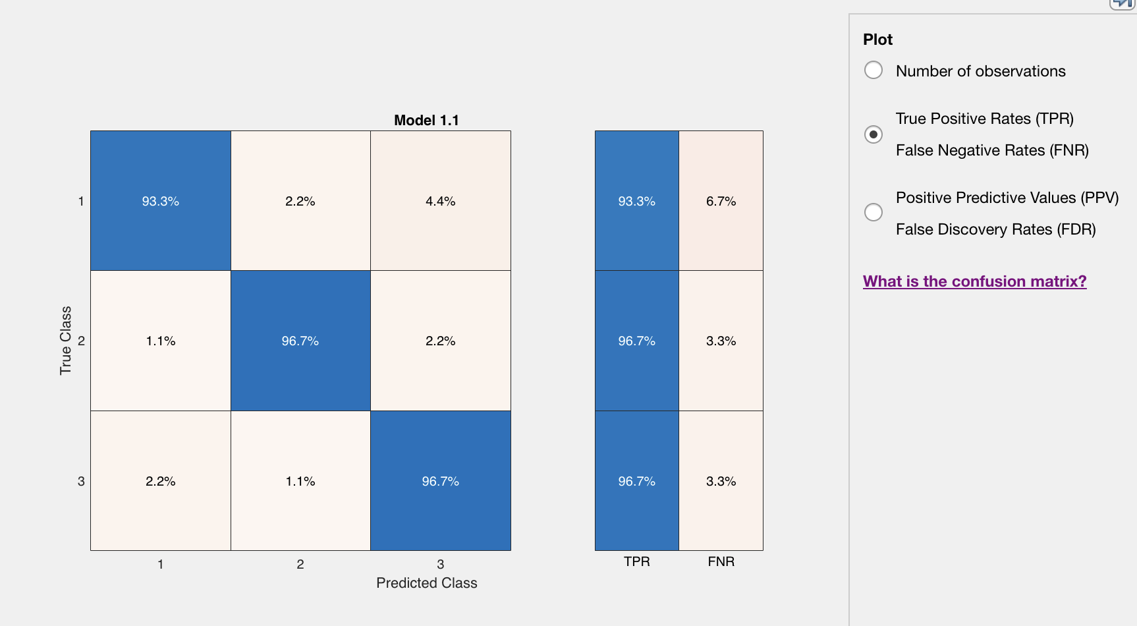
SVM (quadratic)
1 – tetracycline 2 – ceftiofur
3 – cefazoline

Slide 21
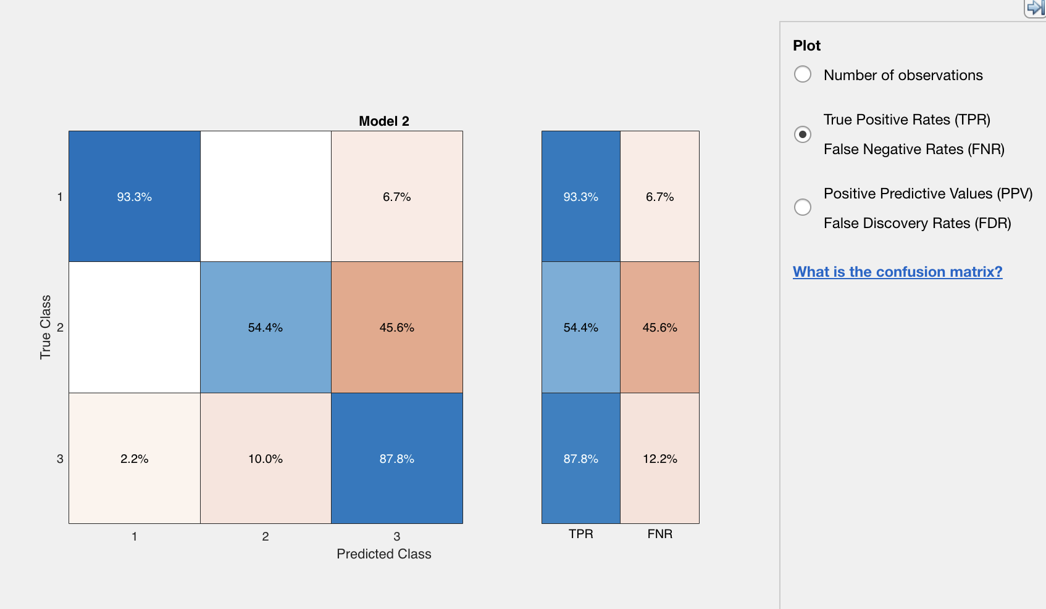
Naive Bayes
1 – tetracycline 2 – ceftiofur
3 – cefazoline

Slide 22
…and there’s always room for improvement
only use second half of the response data (→ equilibrium is reached, so the concentration data is ”more” in agreement with voltammetric data
PCA before classification ☺ (-->peak current & position)
write some code for dataset size adjustment

